Slide 1



Slide 2
CONTENT
1
Basic part
2
Bonus part
3
Q&A

Slide 3
Part 1
Basic part

Slide 4

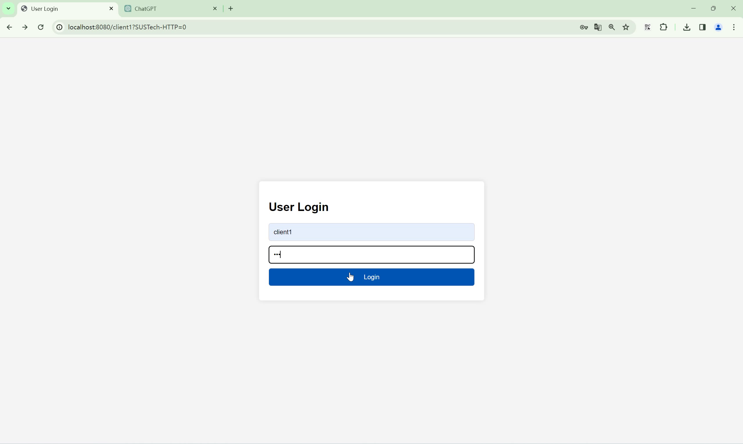
Part1: Overview

Slide 5
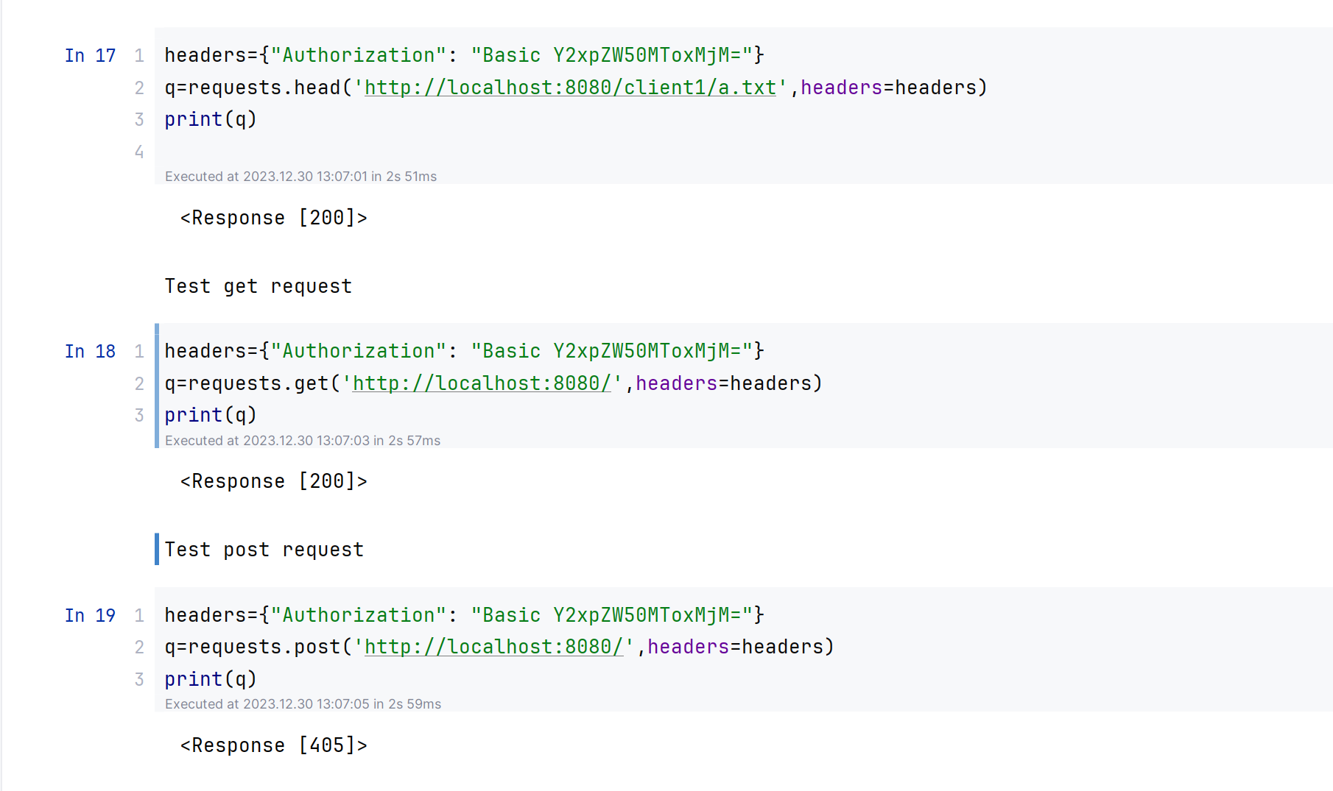
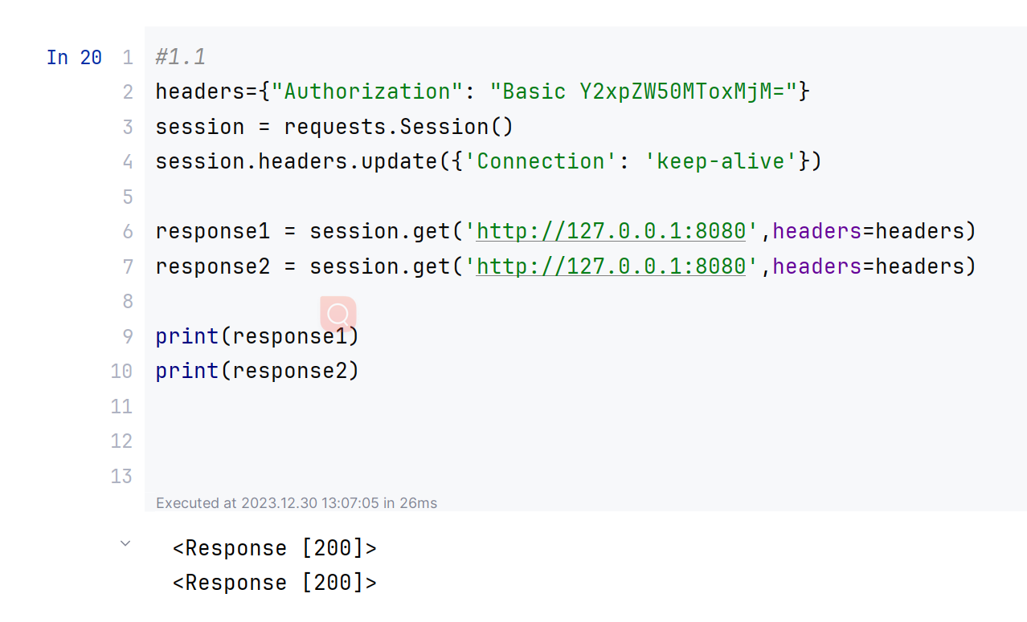
Part1: Test Demo

Slide 6
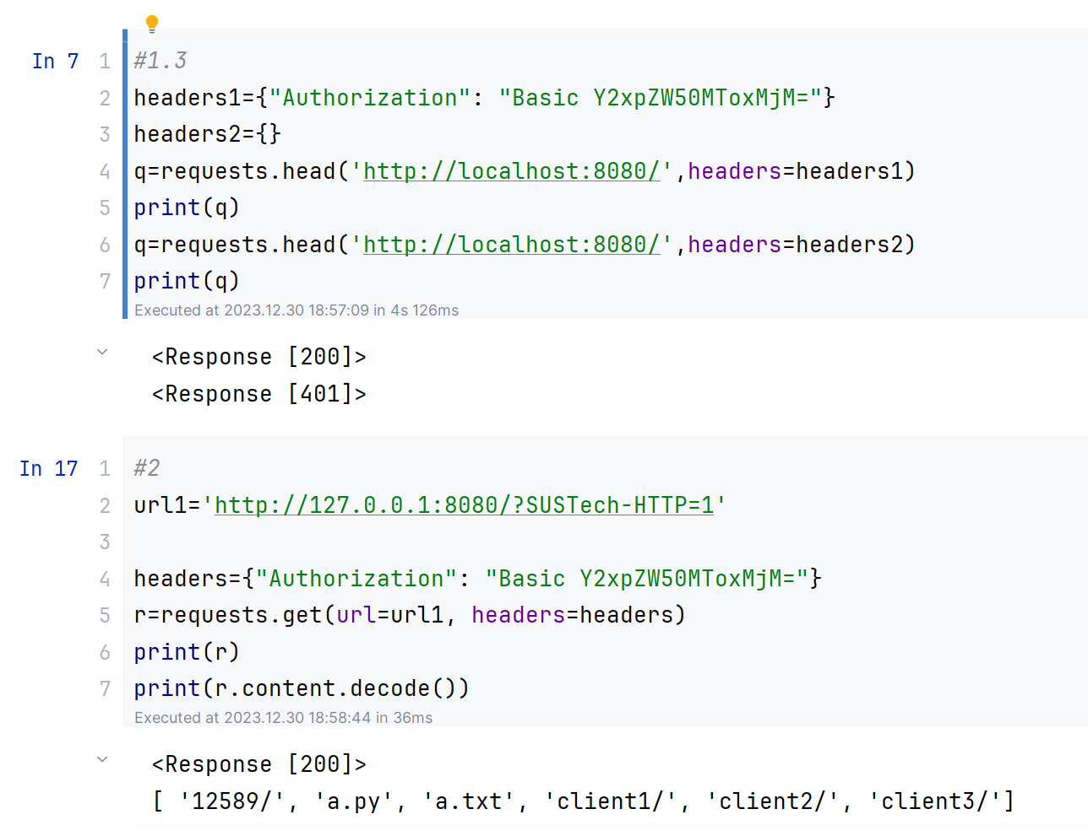
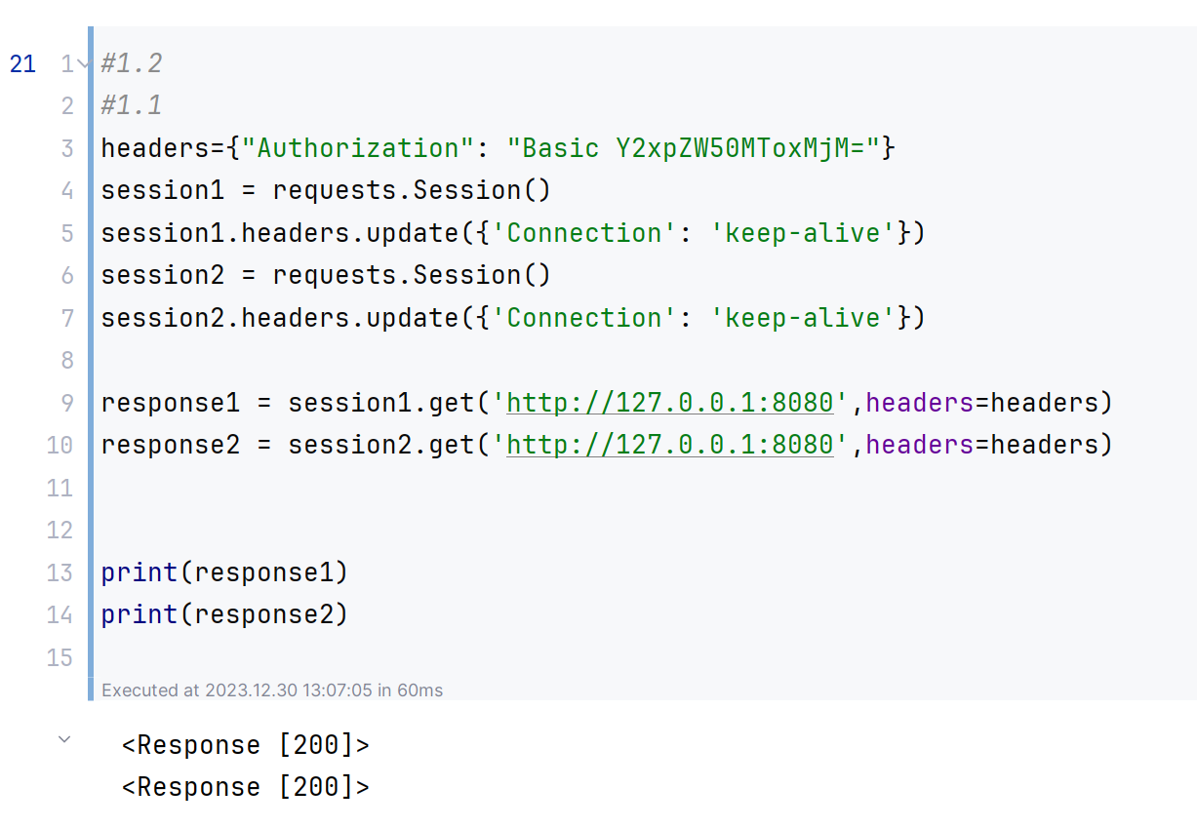
Part1: Test Demo

Slide 7
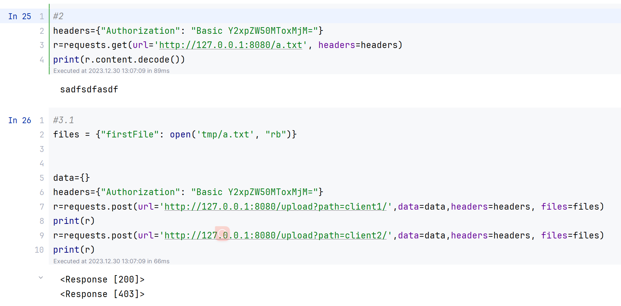
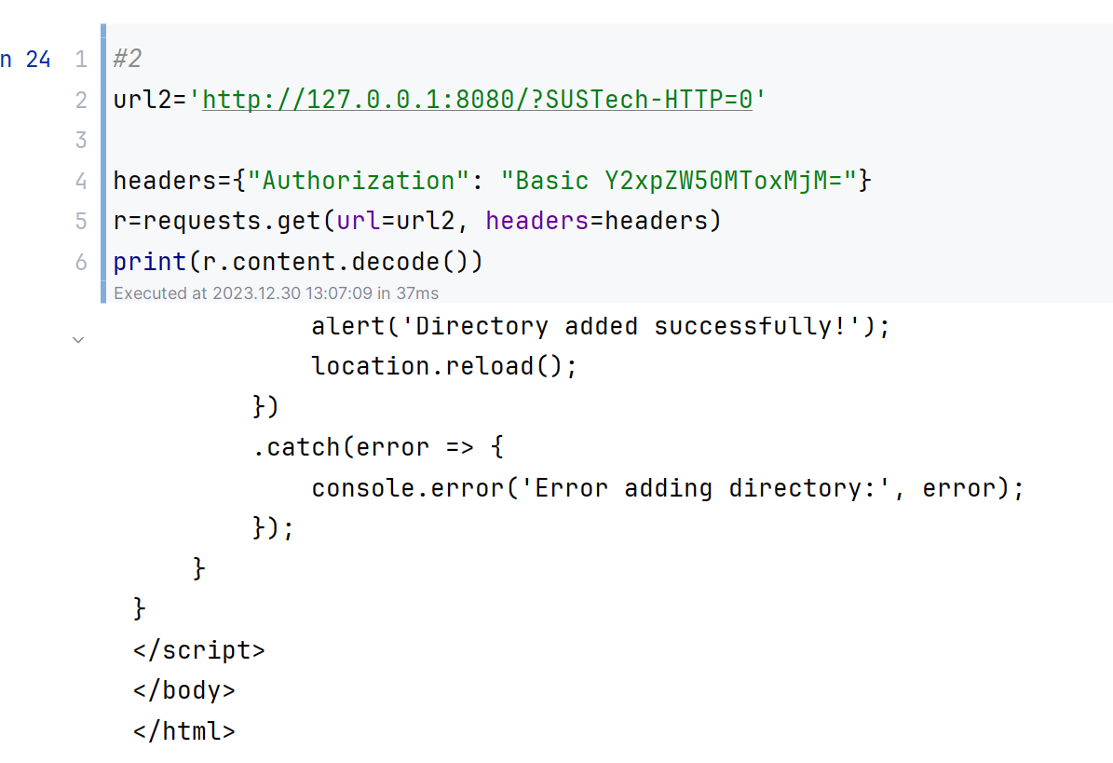
Part1: Test Demo

Slide 8
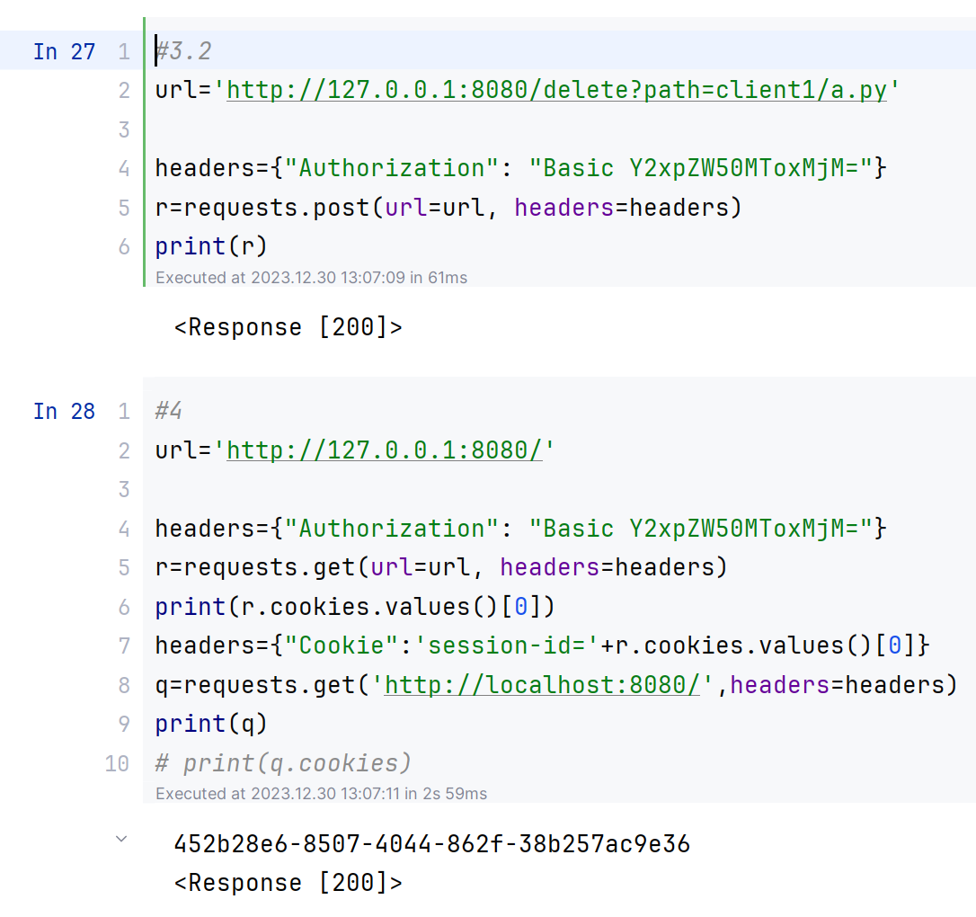
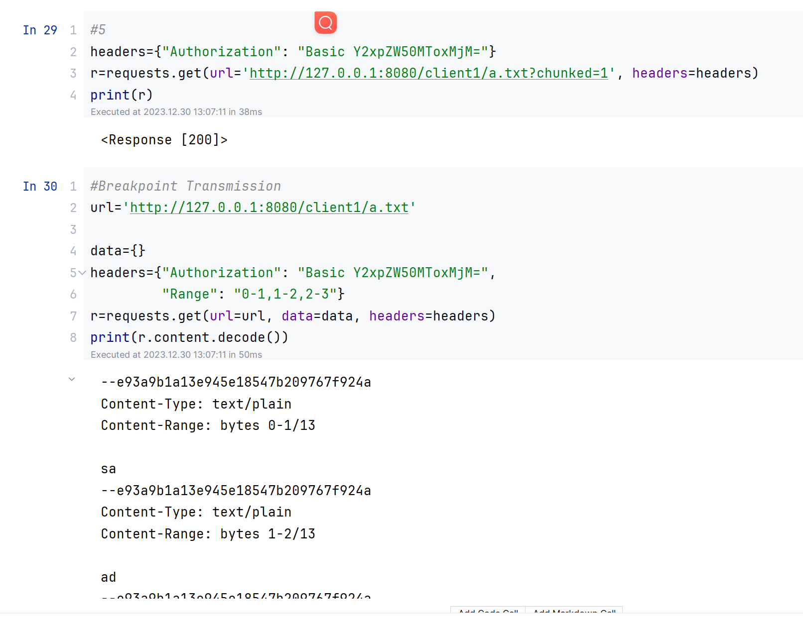
Part1: Test Demo

Slide 9
Part1: HTTP server
Packages:
import argparse
import base64
import socket
import threading
import os
import uuid
import time
import mimetypes
from jinja2 import Template
Packages For Encryption:
from cryptography.hazmat.primitives.asymmetric import rsa
from cryptography.hazmat.backends import default_backend
from cryptography.hazmat.primitives import serialization
from cryptography.hazmat.primitives import hashes
from cryptography.hazmat.primitives.asymmetric import padding
from cryptography.fernet import Fernet

Slide 10
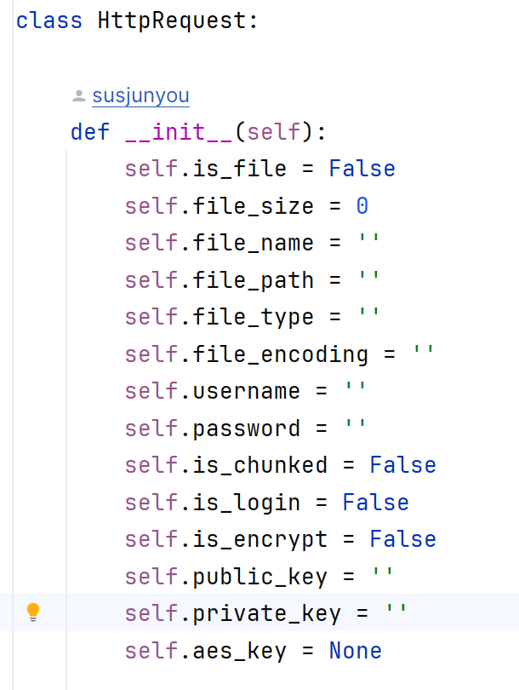
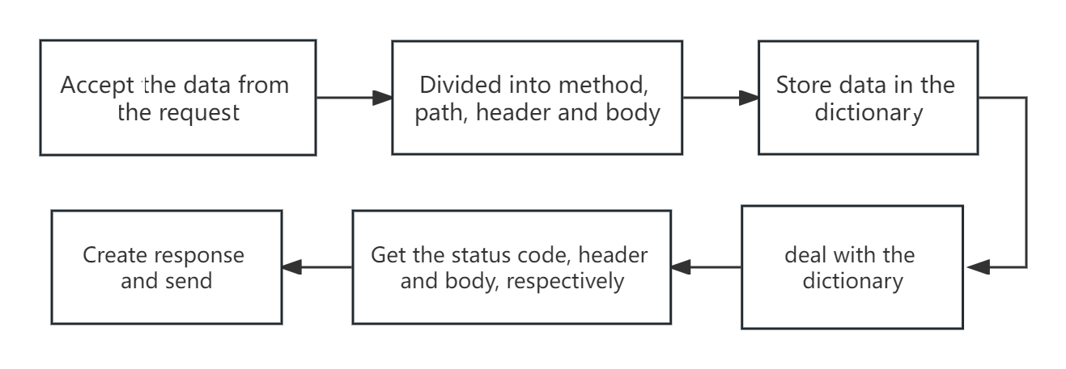
Part1: HTTP server
Encapsulation and Decapsulation:
We use the dictionary data structure to store the requests.
Using a class HttpRequest to store key value of requests.

Slide 11
Part1: HTTP server
Resolve Request Routing
1. GET Request
consider filed ?SUSTech-HTTP=0/1 if Path point to folder
consider the case not include SUSTech-HTTP and Path point to folder, default to return a HTML File
if point to a file, just return the file, Path can not have argument SUSTech-HTTP

Slide 12
Part1: HTTP server
Resolve Request Routing
2. POST Request
the path of upload and delete must point to a file and must have argument(path)
the path of addDirectory (our function) must point to a folder and must have two parameters( path and directory name)
the path of rename (our function) can be both and must have two parameters (path and new name)

Slide 13
Part1: HTTP server
Resolve Request Routing
3. DELETE Request
the path in the URL, and can be file or directory

Slide 14
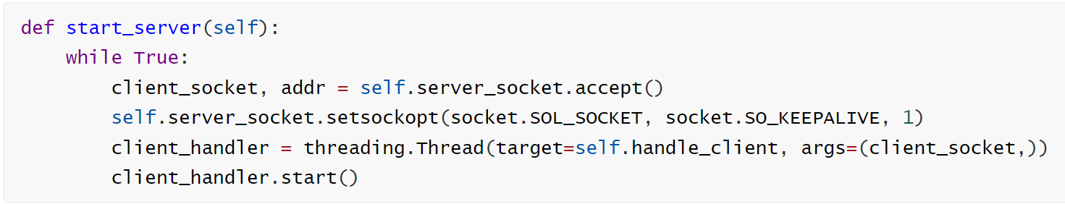
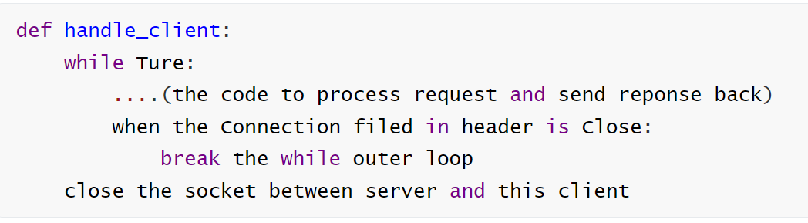
Part1: HTTP server
Handle many clients and connections:
Persistent connection:

Slide 15
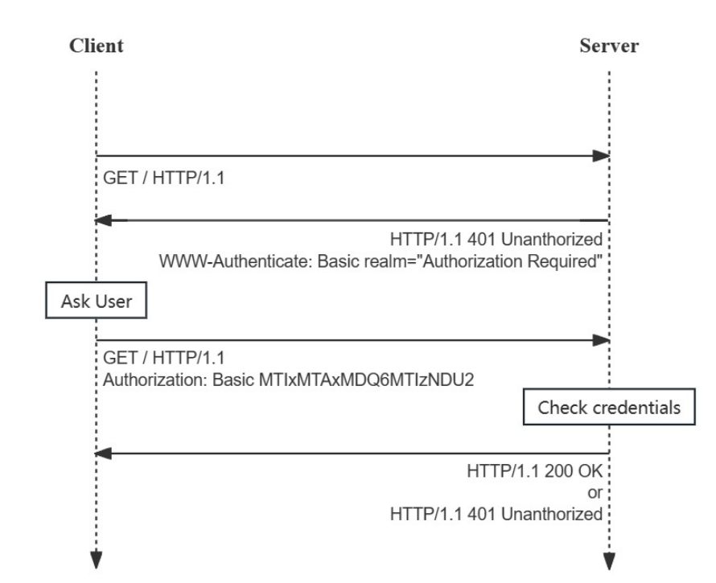
Part1: HTTP server
using a dictionary to store all
username (key) and password(value)
Authorization:
if 'Authorization' in headers:
check whether usrname and
password are correct.
if correct:
send 200
else:
send 401

Slide 16
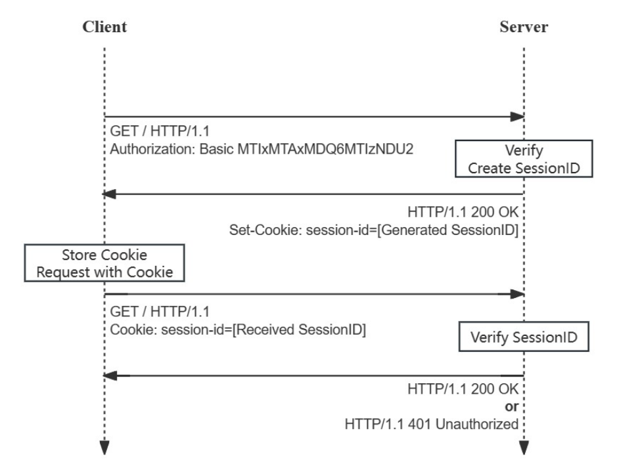
Part1: Cookie and Session
using two dictionary to store users’ cookie and set-cookie time
generate cookie by uuid
if 'Cookie' in headers:
verification of sessionID
if correct:
if cookie times out:
send 401
else:
set this user’s cookie time to now
send 200

Slide 17
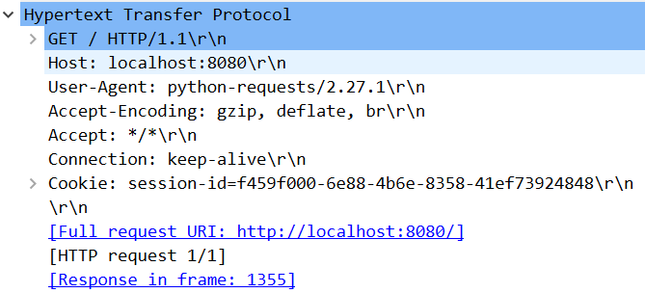
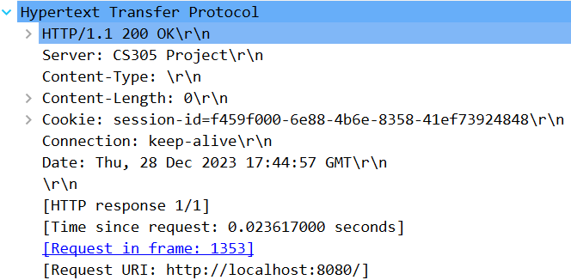
Part1: Cookie and Session
Cookie:
request
response

Slide 18
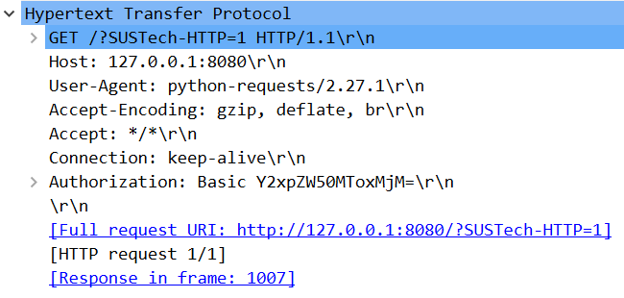
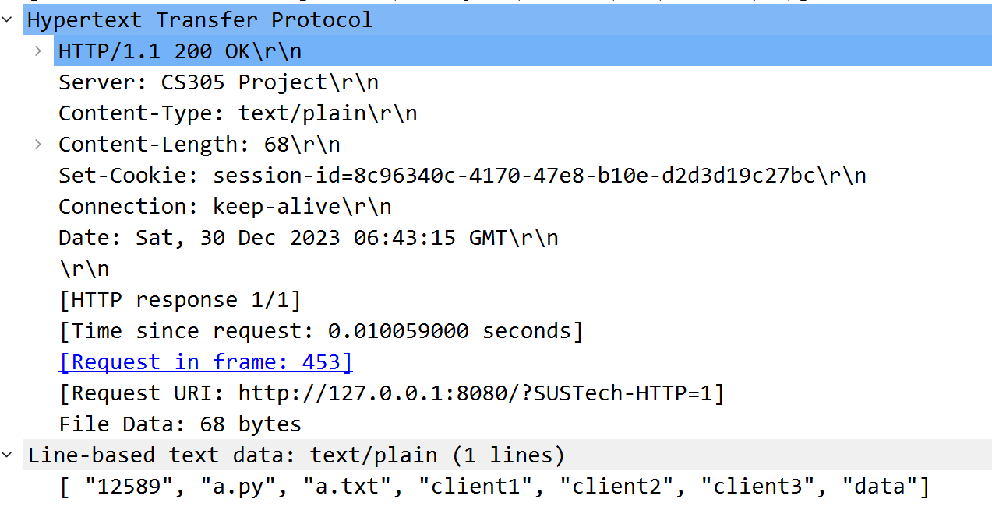
Part1: View, Download, Upload and Delete
View: SUSTech-HTTP=1
request
response

Slide 19
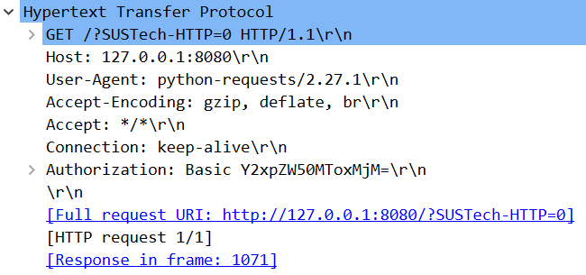
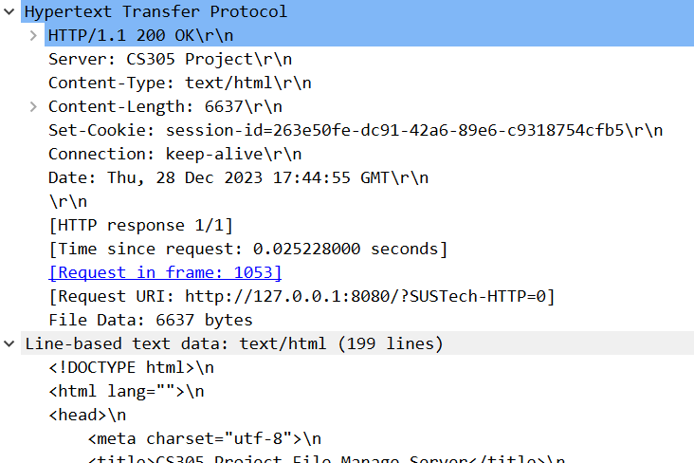
Part1: View, Download, Upload and Delete
View: SUSTech-HTTP=0
request
response

Slide 20
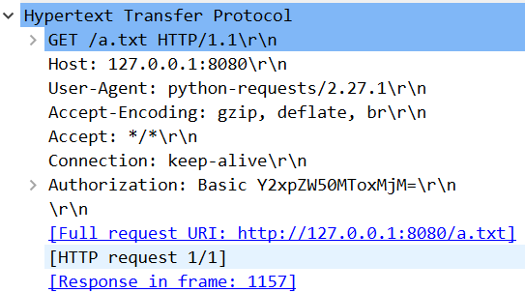
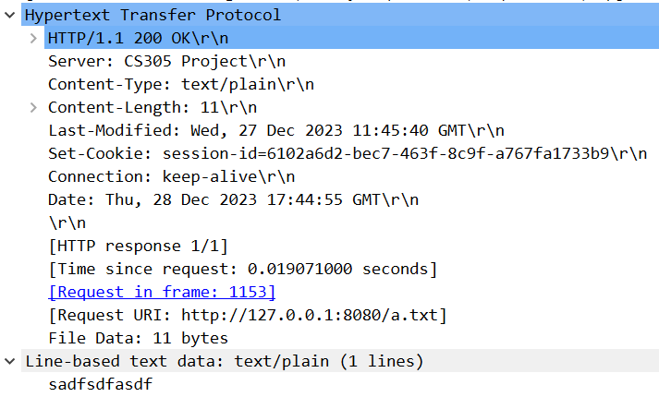
Part1: View, Download, Upload and Delete
Download:
request
response

Slide 21
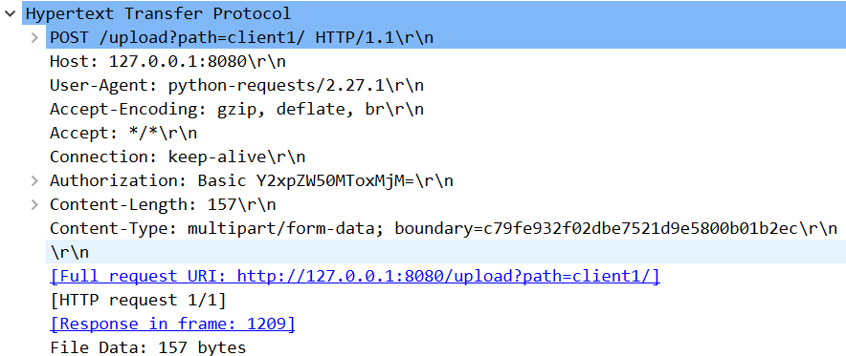
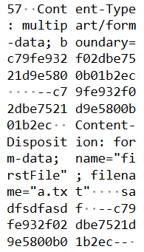
Part1: View, Download, Upload and Delete
Upload:
request from client1

Slide 22
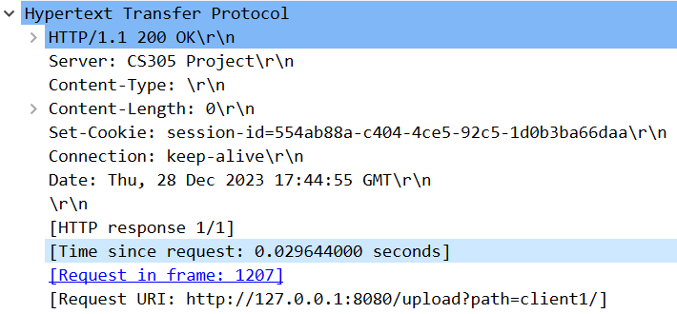
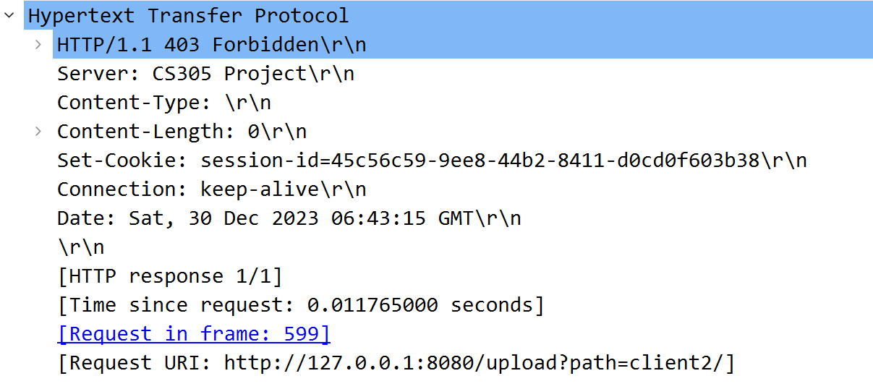
Part1: View, Download, Upload and Delete
Upload:
response to client1
response to client2

Slide 23
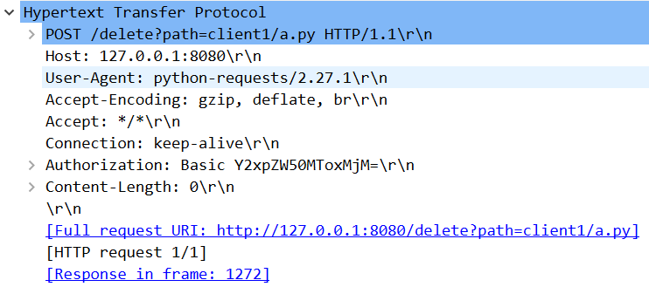
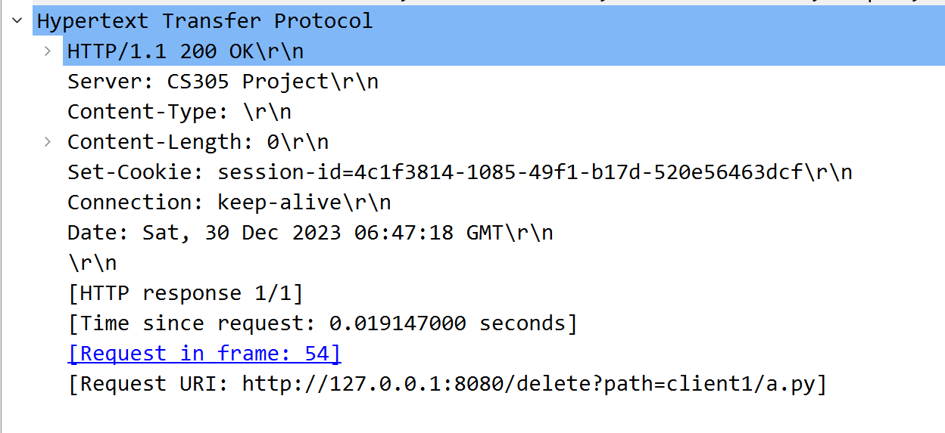
Part1: View, Download, Upload and Delete
Delete:
request
response

Slide 24
Part1: View, Download, Upload and Delete
If the request URL does not exist in your server, server should return 404 Not Found.
If the client access the file-getting API with other methods instead of GET method, the server should return 405 Method Not Allowed.
If the format of the request URL or the required query parameters are invalid, server should return 400 Bad Request.
If there is no authorization information inside the HTTP request, or the authorization is invalid for server to accept, server should return 401 Unauthorized.
If the authorization information is not the user "11912113", this request is also invalid since there is no permission for other user to upload file to /data/11912113/ , and server should return 403 Forbidden.

Slide 25
Part1: View, Download, Upload and Delete
boundary cases should be specially handled:
When download:
Method must be GET
Check Authorization or Cookie
URL is point to folder or file
The file size
The folder where the downloaded file resides does not exist
The downloaded file does not exist
Chunked Transfer
Breakpoint Transmission (multi range or single range)

Slide 26
Part1: View, Download, Upload and Delete
boundary cases should be specially handled:
When upload:
Method must be POST
The folder where the uploaded file resides does not exist
The name of the uploaded file already exists
User only has permission to modify their own directory
Consider the parameters
When delete:
Method must be POST
The deleted file does not exist.
User only has permission to modify their own directory

Slide 27
Part1: View, Download, Upload and Delete
boundary cases should be specially handled:
When upload/delete:
Method must be POST
The folder where the uploaded file resides does not exist(only upload)
The deleted file does not exist.(only delete)
The name of the uploaded file/folder already exists(only upload)
User only has permission to modify their own directory
Consider the parameters

Slide 28
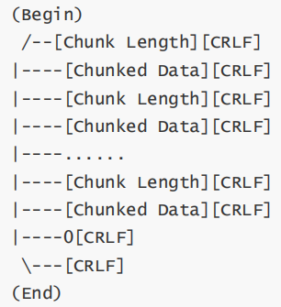
Part1: Chunked Transfer
When 'chunked=1' in path and method is GET:
send the status code and header first,
and then send the body in pieces
Body format

Slide 29
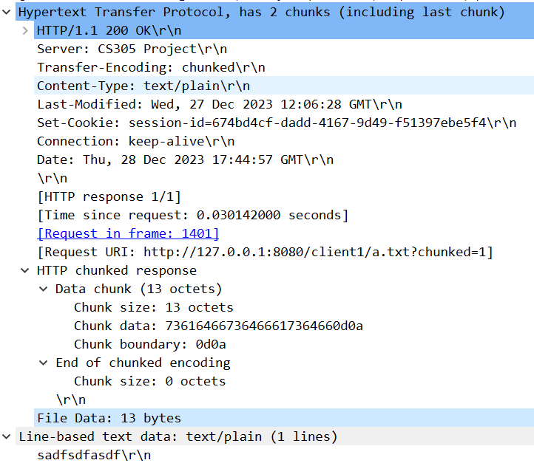
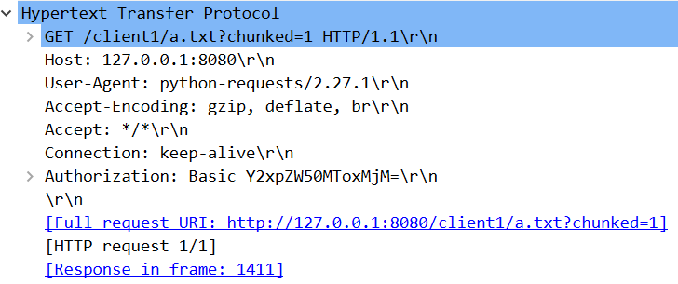
Part1: Chunked Transfer
response
Chunked Transfer(test demo):
request

Slide 30
Part 2
Bonus part

Slide 31
Part2: Breakpoint Transmission
When 'Range' in headers and method is GET:
If received bytes range is valid, then response with the bytes content of the corresponding range, and include the header Content-Range in response correctly with 206 Partial Content.
If the range is not valid for the request file, server should return 416 Range Not Satisfiable.
For example, 10-9/100 and 100-200/100 are invalid ranges, where the right bound is smaller than the left bound in the first example, and the second range has exceed the file size of the request file.

Slide 32
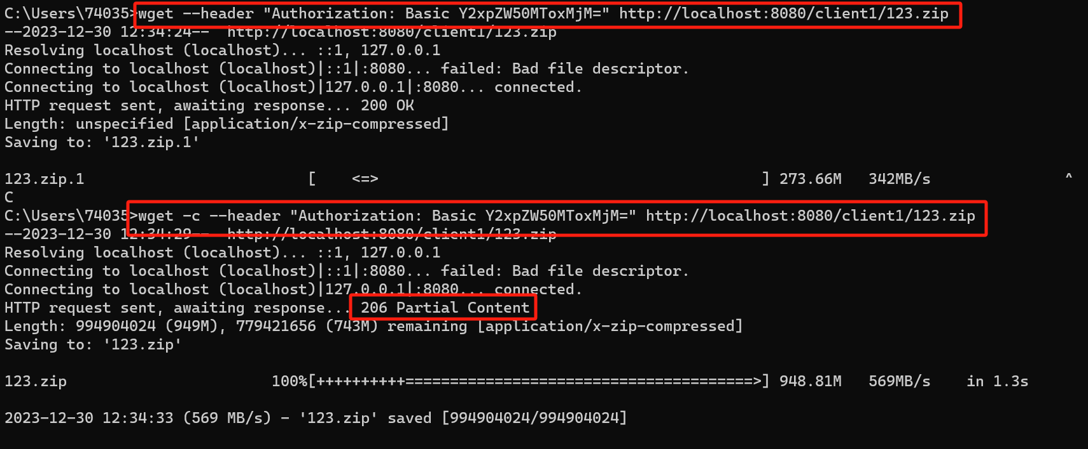
Part2: Breakpoint Transmission
*Show1: suspension and continuation of transmission

Slide 33
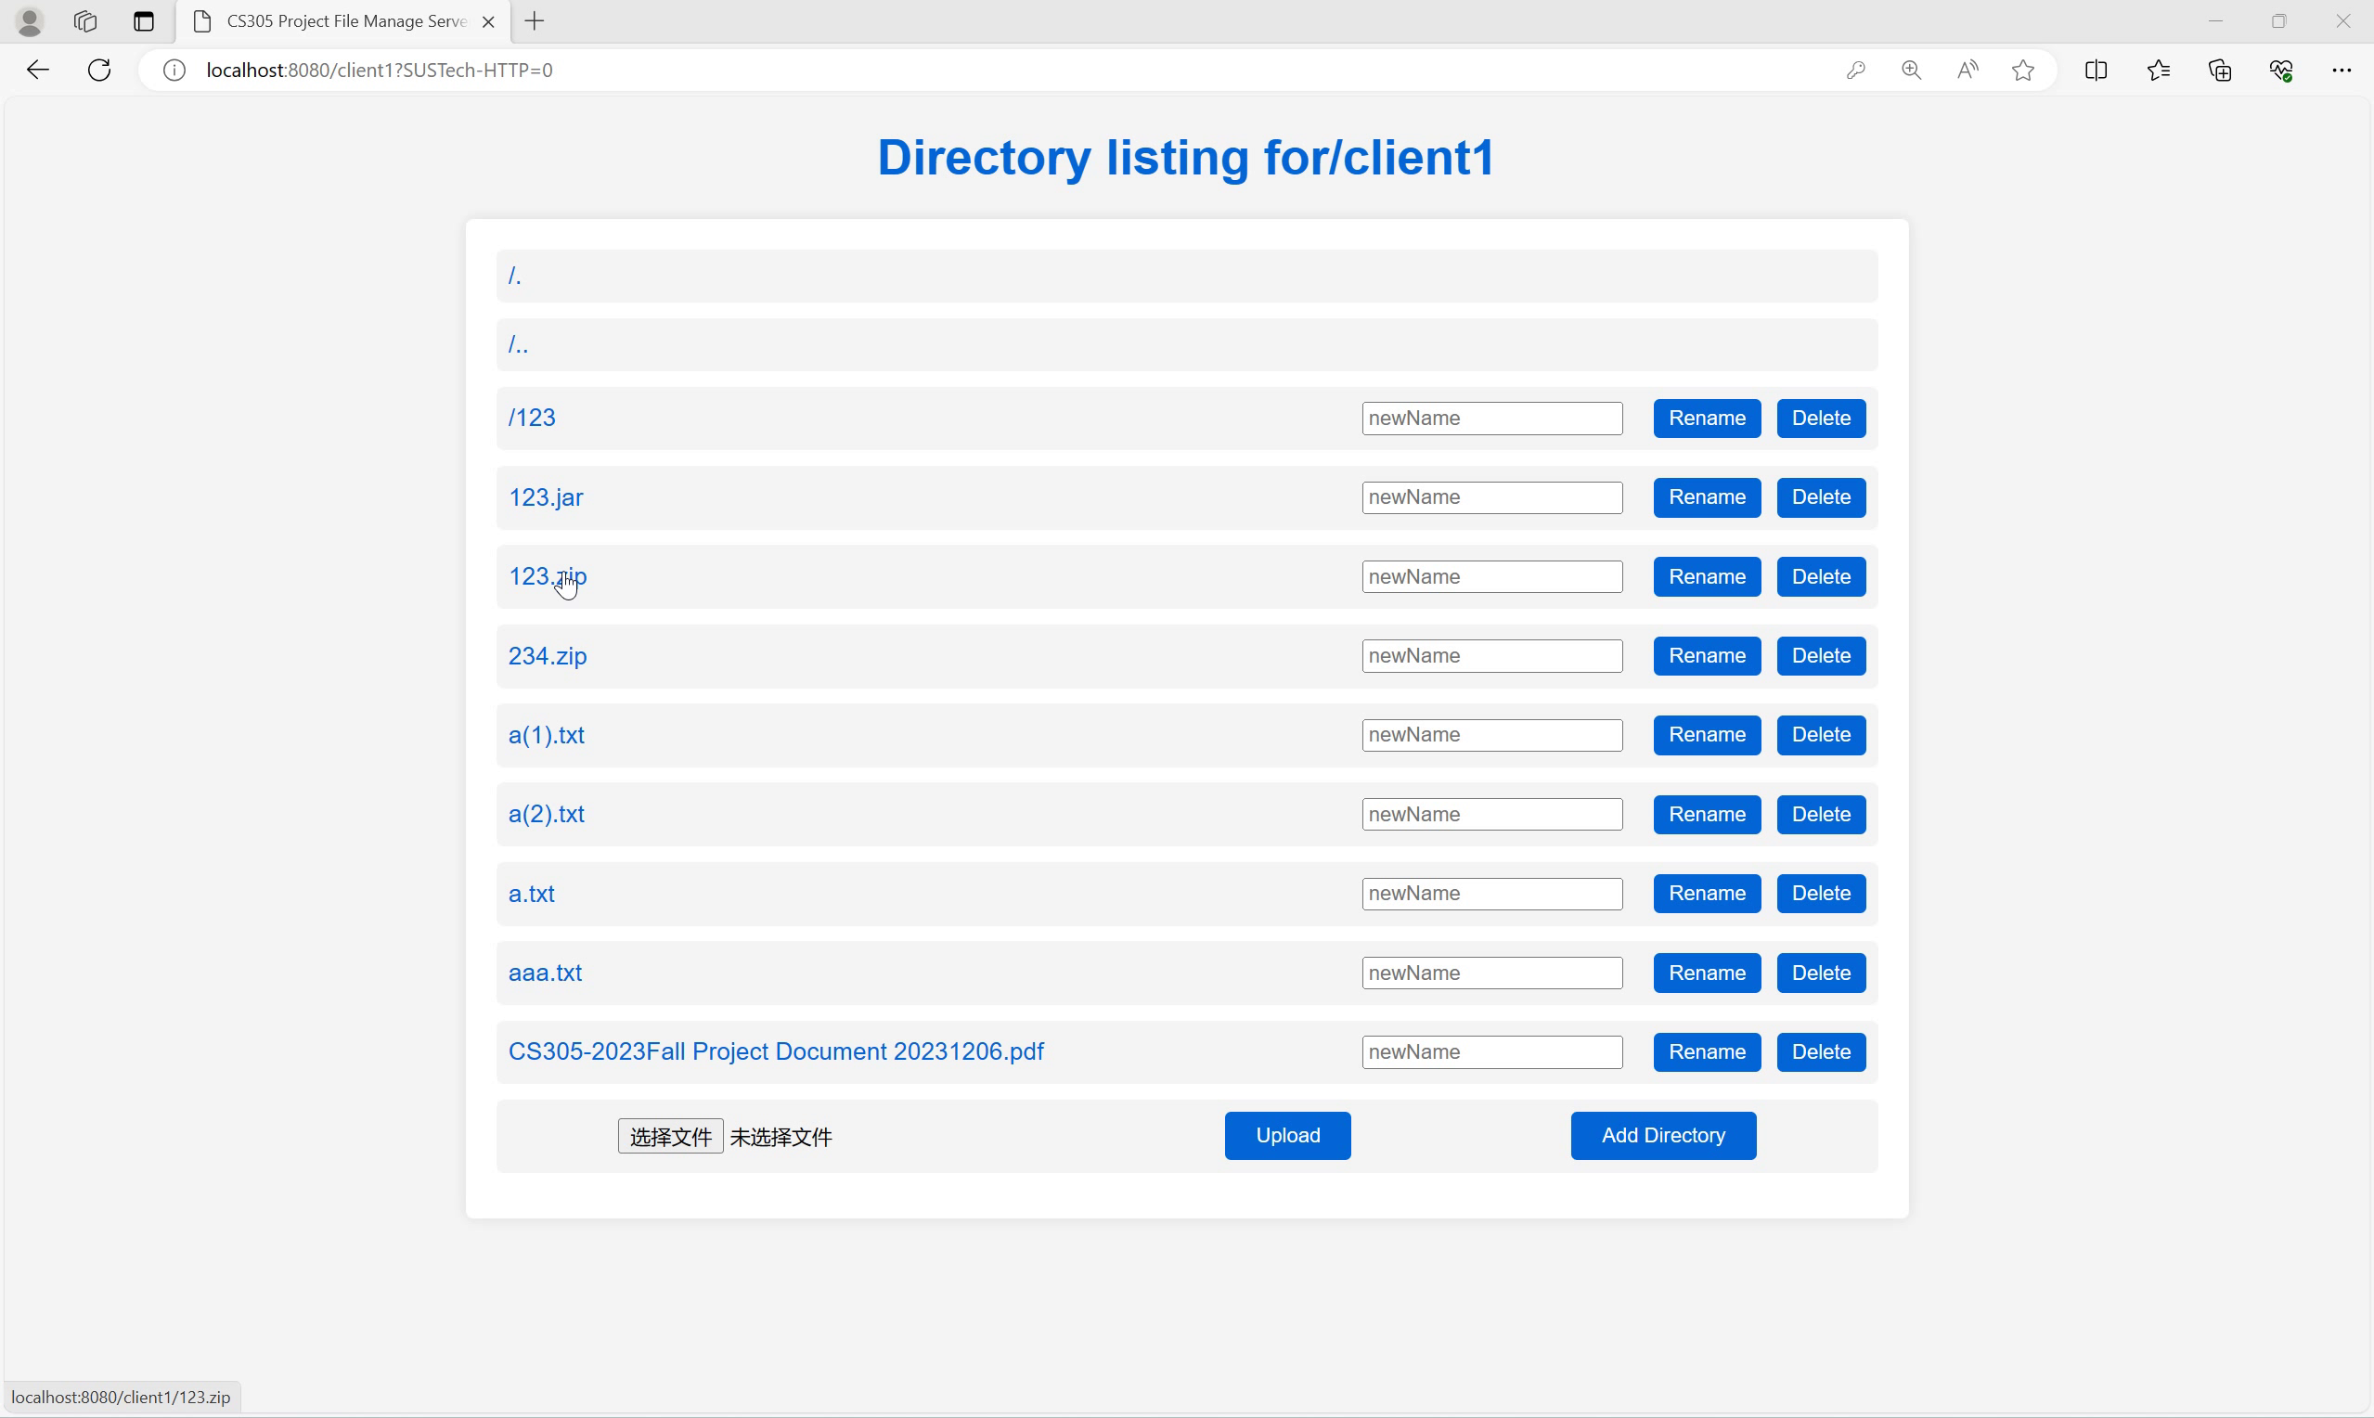
Part2: Breakpoint Transmission
*Show1: suspension and continuation of transmission

Slide 34
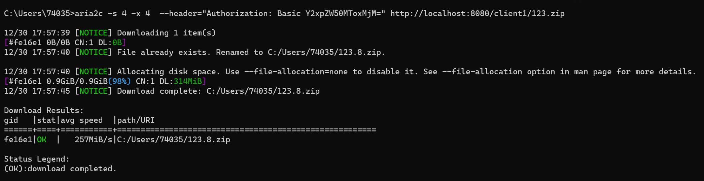
Part2: Breakpoint Transmission
*Show2: support concurrency handling

Slide 35
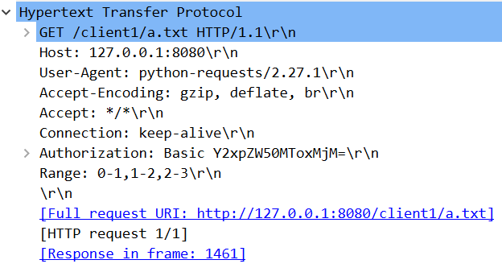
Part2: Breakpoint Transmission
Breakpoint Transmission:
request

Slide 36
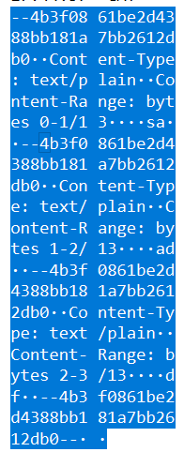
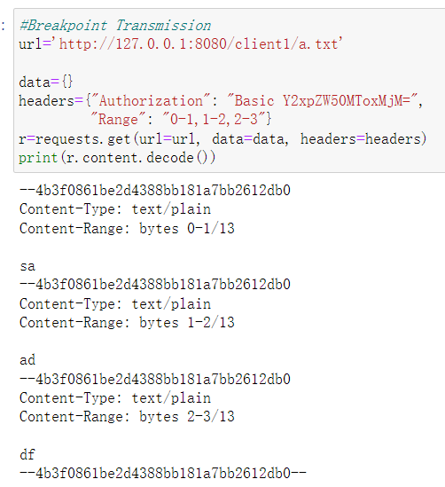
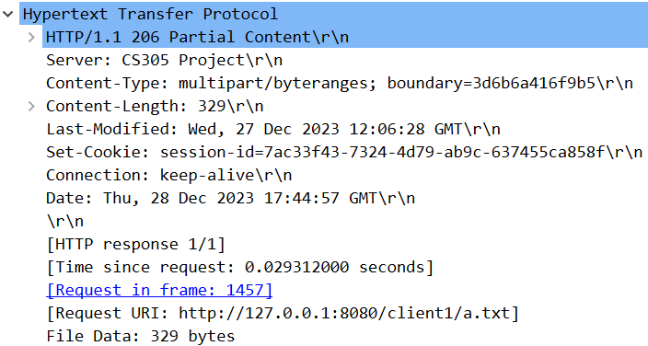
Part2: Breakpoint Transmission
range只有一个和range有多个 的格式不一样
Breakpoint Transmission:
response

Slide 37
Part2: SpeedTest for File Downloading

Slide 38
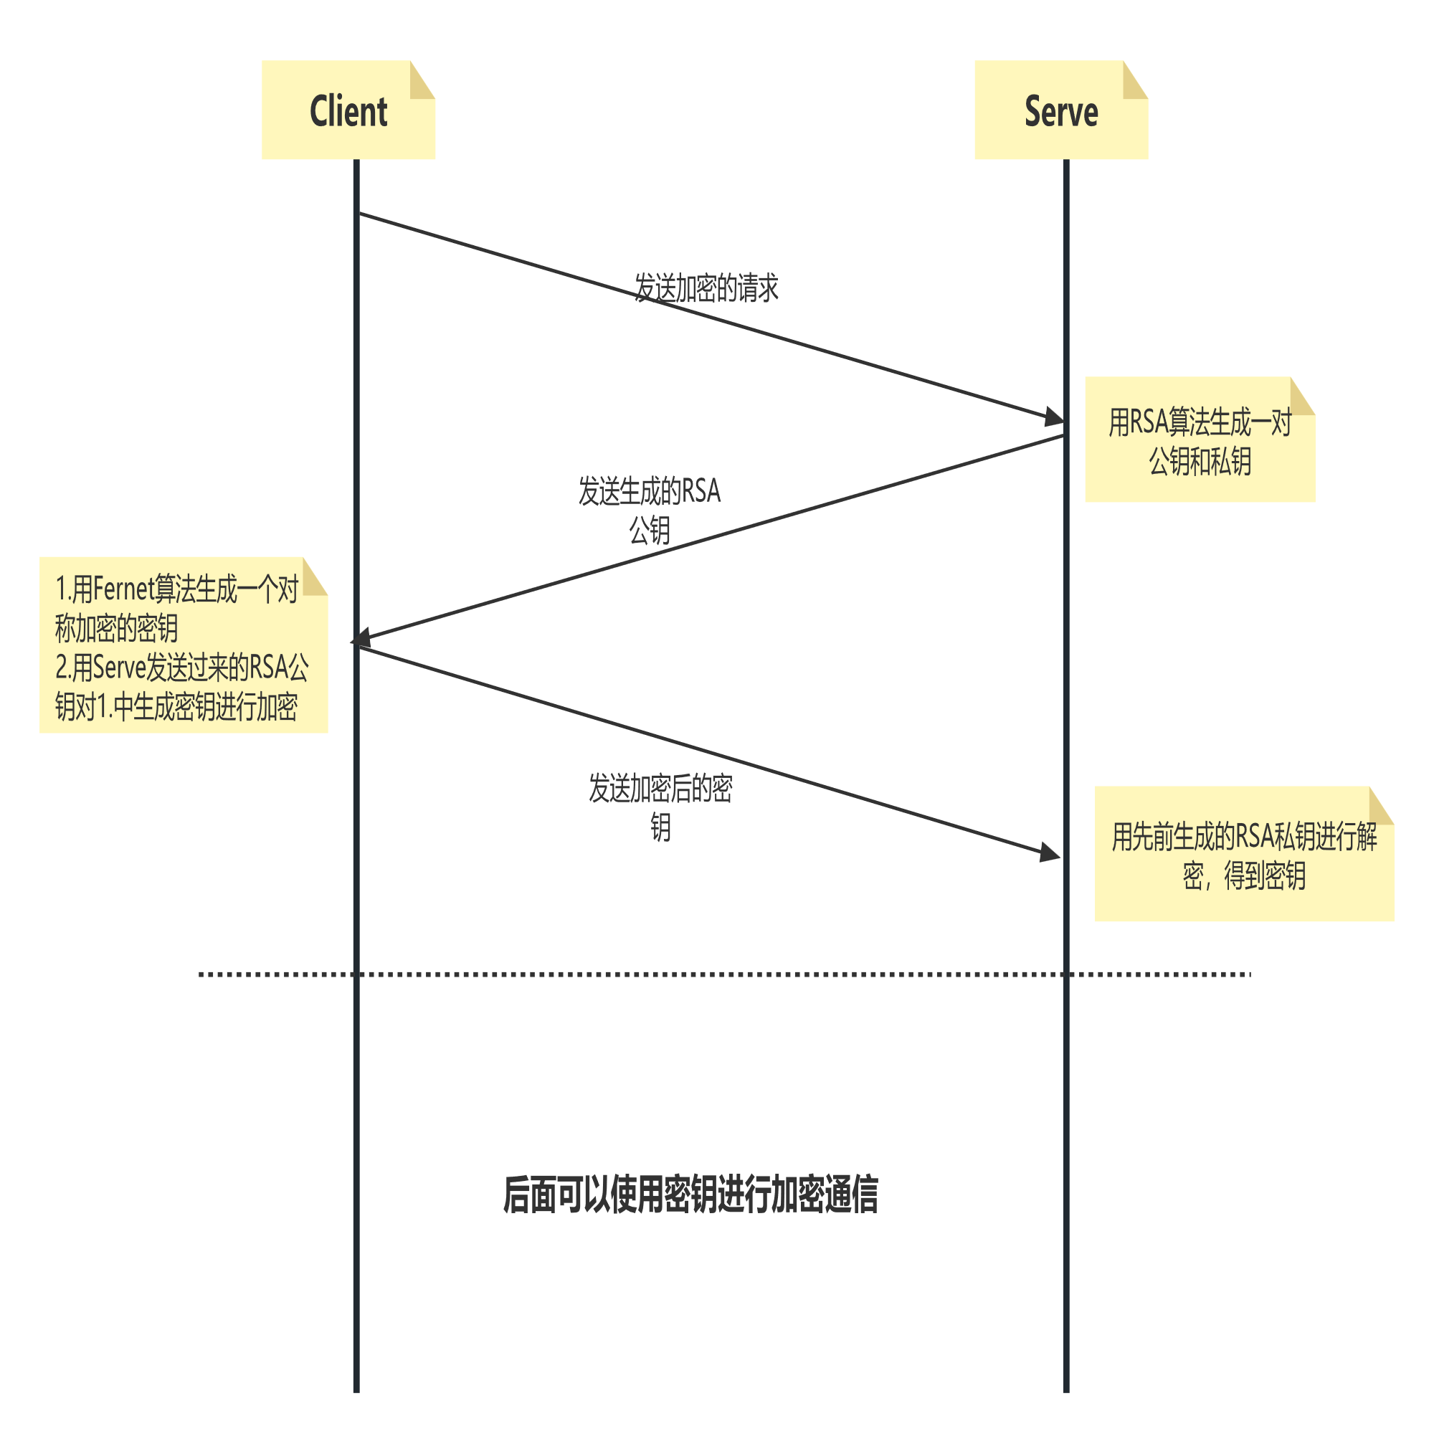
Part2: Encryption

Slide 39
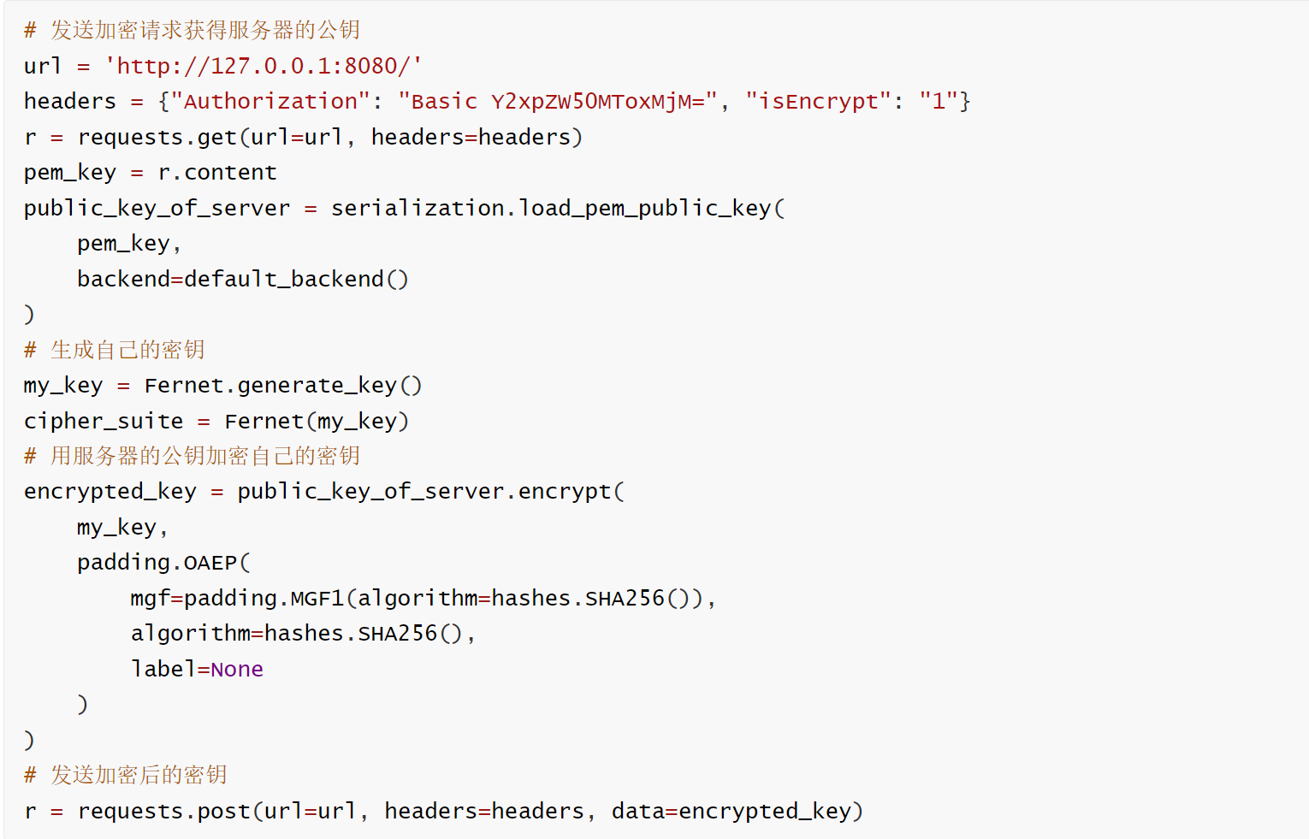
Part2: Encryption
Build encrypt connection:

Slide 40
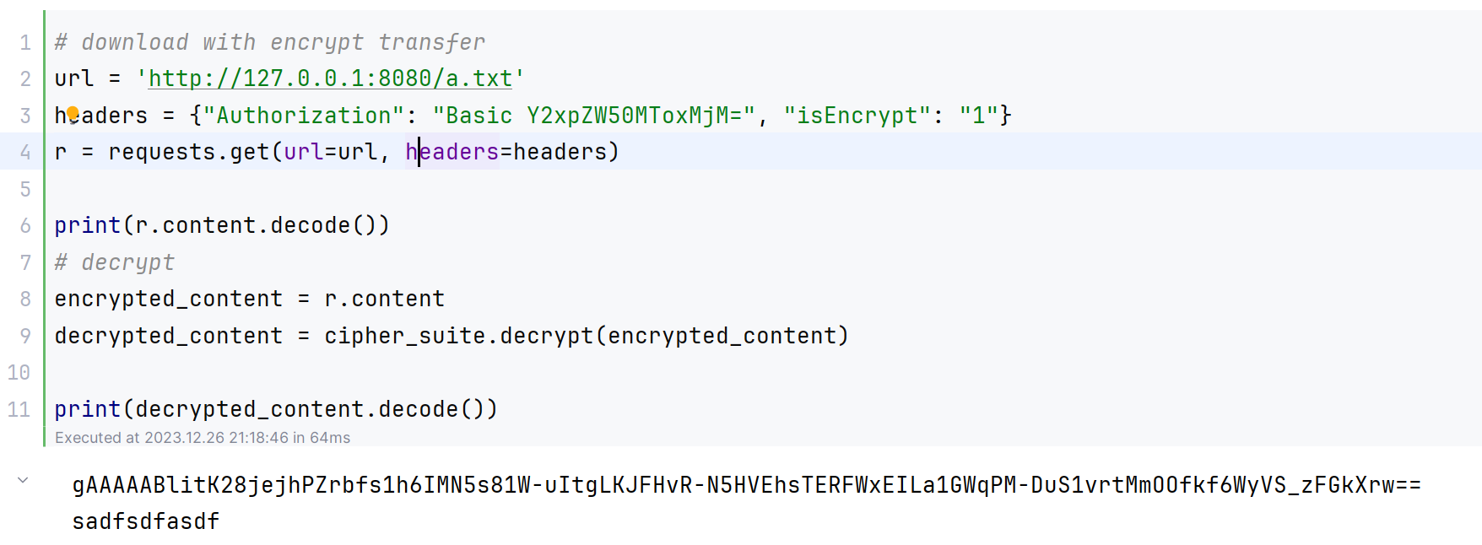
Part2: Encryption
Download with encrypt transfer

Slide 41
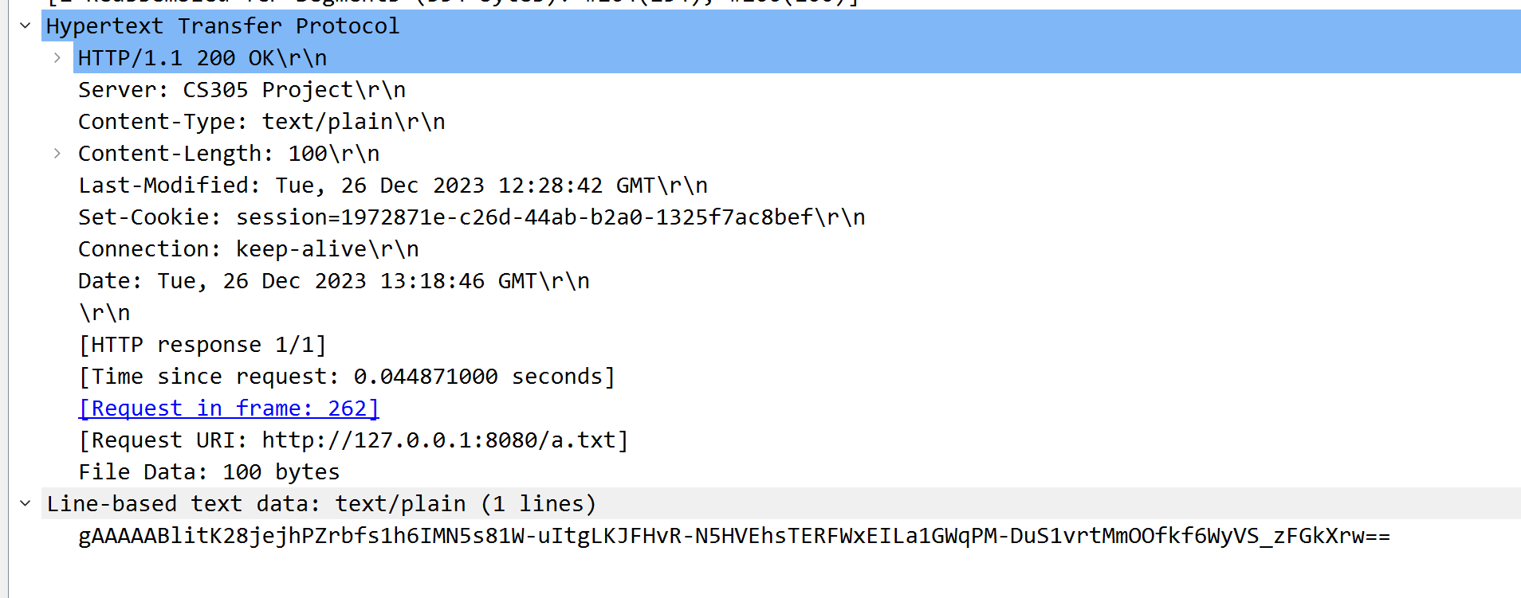
Part2: Encryption
Download with encrypt transfer(Wireshark)

Slide 42
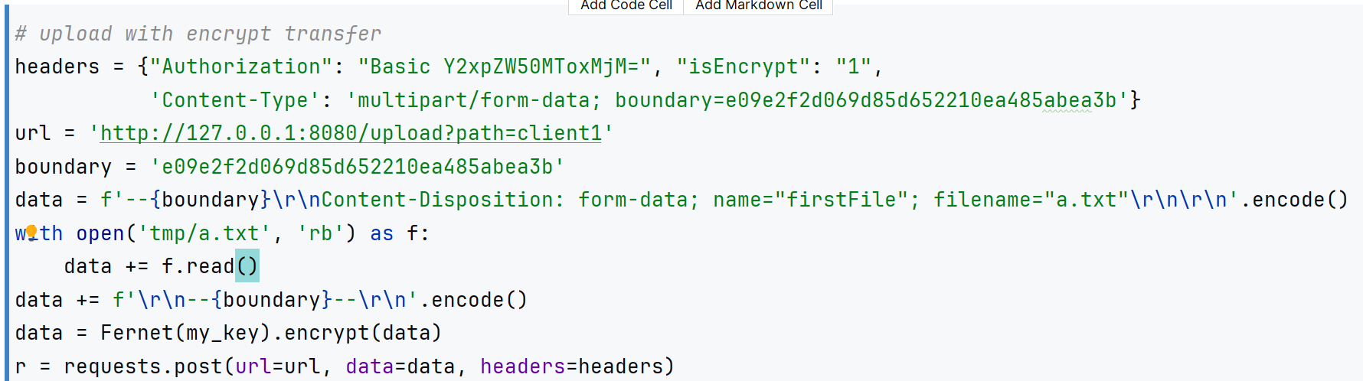
Part2: Encryption
Upload with encrypt transfer:

Slide 43
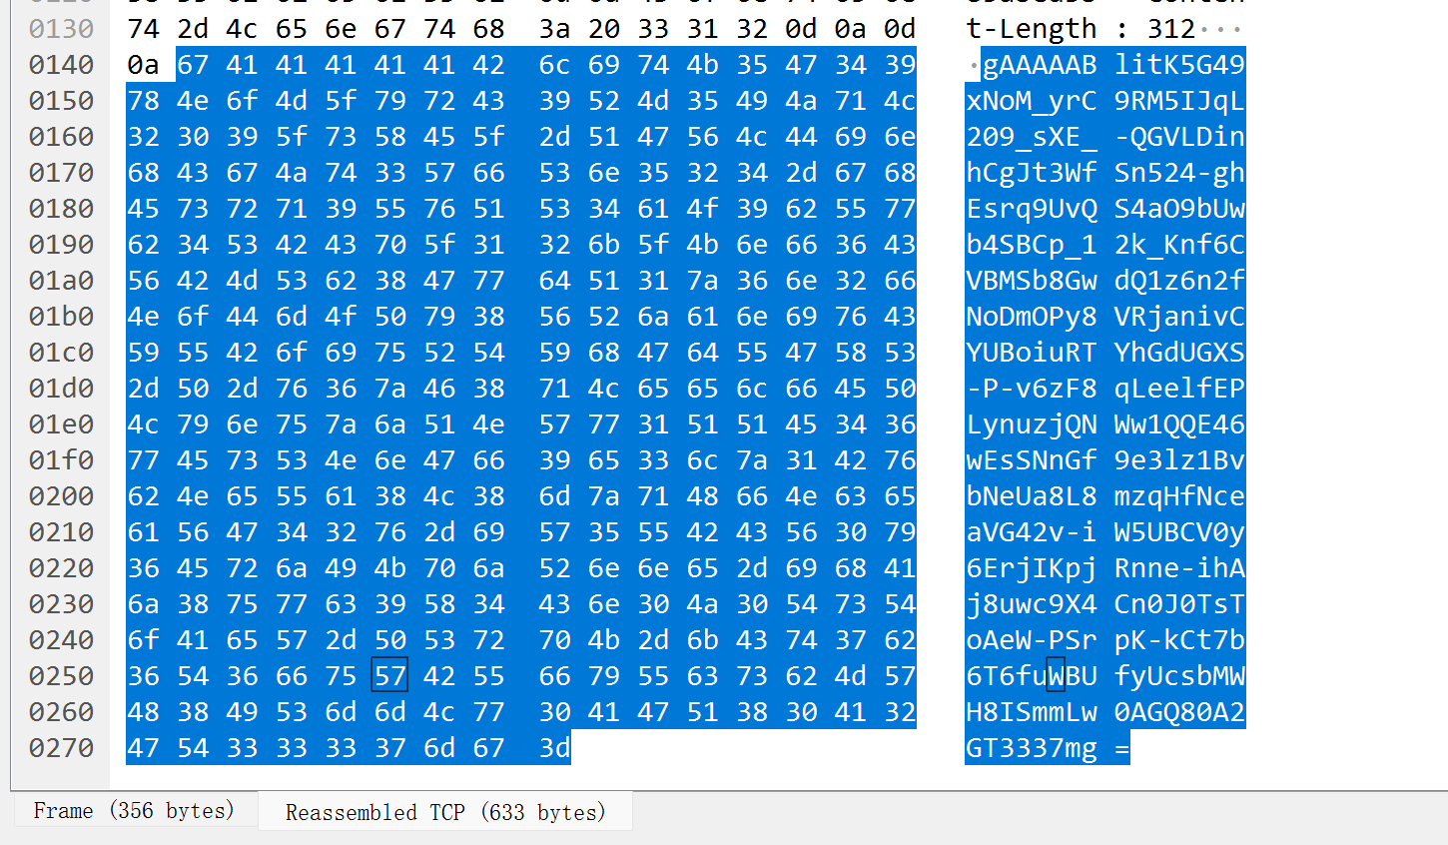
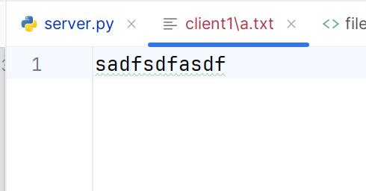
Part2: Encryption
Upload with encrypt transfer(Wireshark)

Slide 44
Part2: Other
重名处理
addDirectory
rename
DELE Method
完整的前端实现

Slide 45
Part 3
Q&A

Slide 46
Part3: Q&A

Slide 47
Thank you for your listening！

